Slide 1



bit.ly/ionkerul
Ionic T01 Intro

Slide 2
bit.ly/ionkerul
Ionic5

Slide 3


Slide 4
OVERVIEW
TO IONIC FRAMEWORK

Slide 5

What is Ionic?
Ionic Framework is an open source UI toolkit for building performant, high-quality mobile and desktop apps using web technologies (HTML, CSS, and JavaScript).

Slide 6
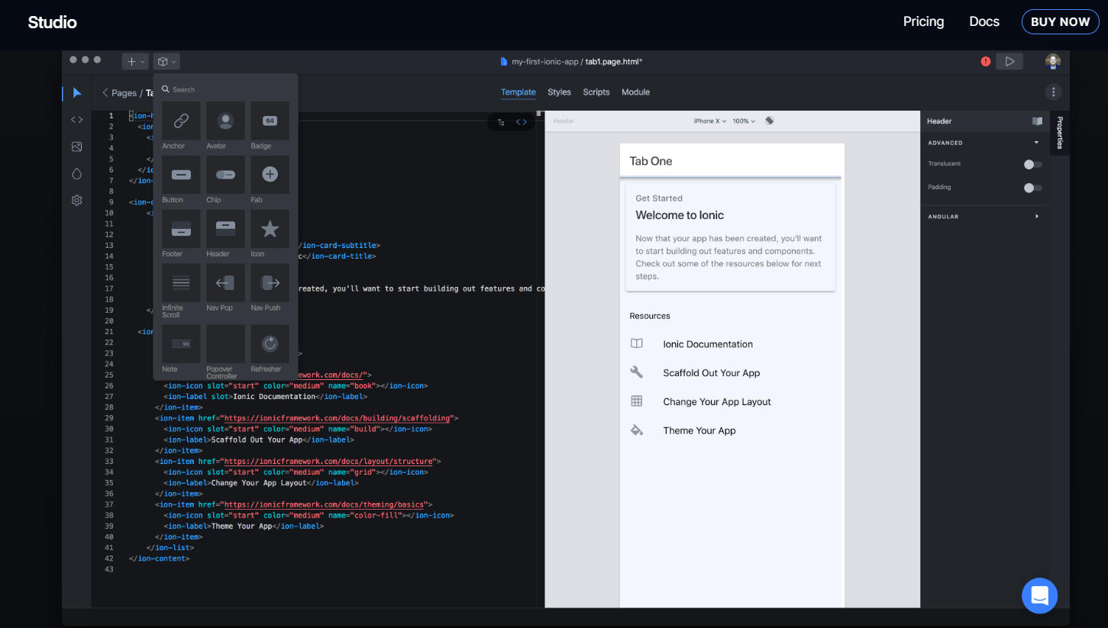
Ionic Studio

Slide 7
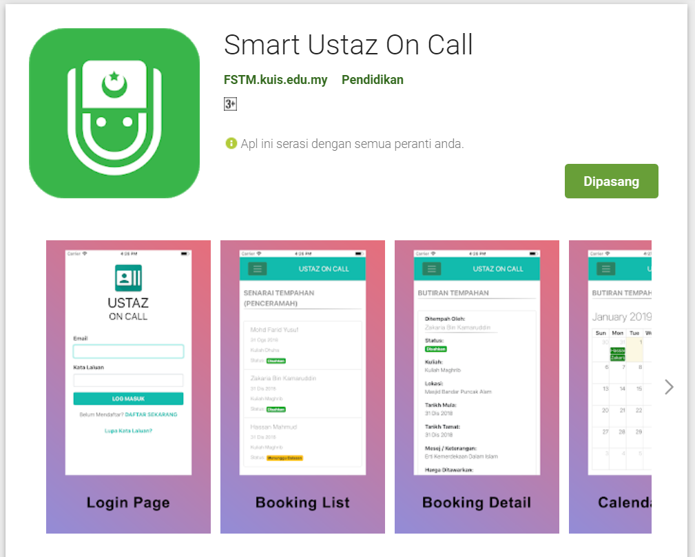
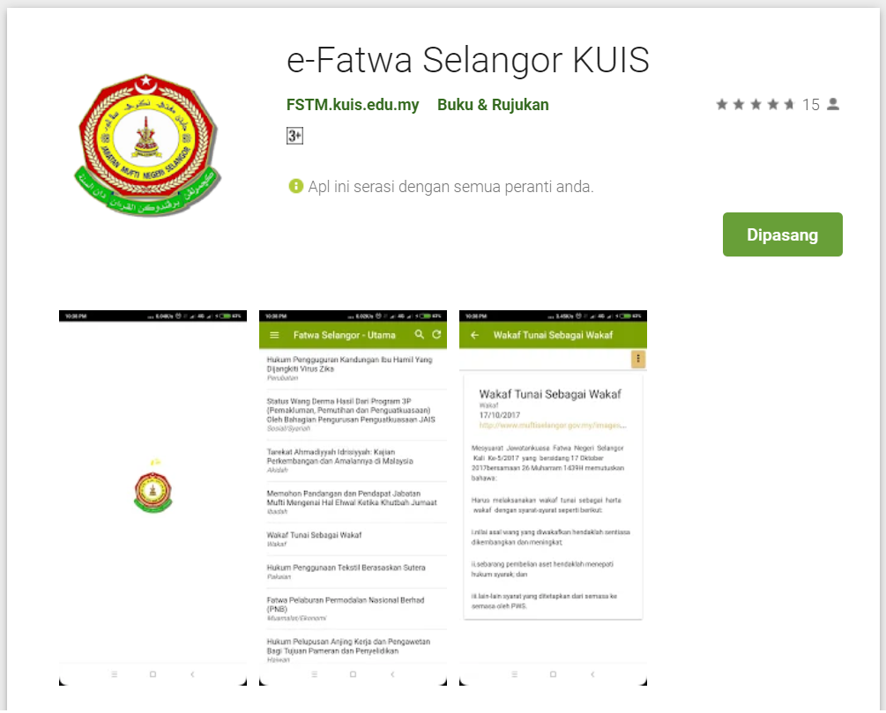
Available apps

Slide 8
IOS & Android Software Development
In a nutshell

Slide 9





Android Studio
(Java & Kotlin)
Android Device
NATIVE - 2 X WORK
XCode (Swift & Objective C)
iPhone/iPad

Slide 10

1 x WORK
Compile with Android SDK
Android Device
Cordova
Framework
Hybrid
XCode Project
iPhone/iPad

Slide 11
Cordova
Framework
Hybrid
WEB LAYER
NATIVE APP

Slide 12
1 x WORK
Build Progressive Web Apps
Android Device
Build Progressive Web Apps
Cordova
Framework
Hybrid
iPhone/iPad

Slide 13


1 x WORK
Android Studio
Android Device
+
XCode
iPhone/iPad

Slide 14
https://capacitor.ionicframework.com/

Slide 15



WHY IONIC?
Framework specifically to develop apps
Multiple platforms-Android, IOS, Windows, Amazon etc
Apps development using HTML & Typescript (subset of Javascript)
Plugins (camera, thumbprint, bluetooth, printer etc etc etc)

Slide 16
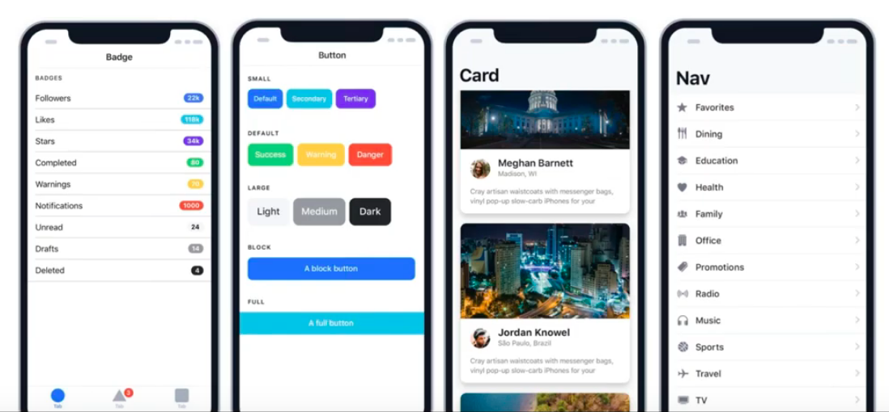
WHY IONIC?
Large COMMUNITY for support
Pre built gestures & animation
100+ UI Components
Everything is OPEN SOURCE
Built with Ionic

Slide 17
Software to start Ionic?

Slide 18
What do you need?
To run IONIC:
Node Package Manager (NPM)
Ionic Cordova Framework
Google Chrome Web Browser
To develop/publish app
VSCode OR any other IDE (with Typescript Plugin)
Ionic Capacitor
Android SDK or Xcode - can be done later

Slide 19
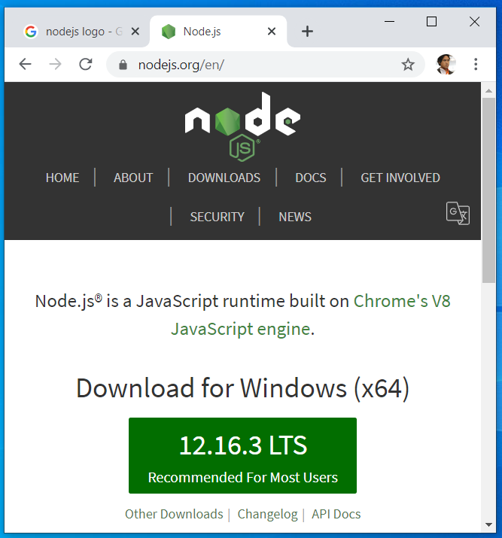

Download from nodejs.org
Download and install the LTS version
http://nodejs.org

Slide 20
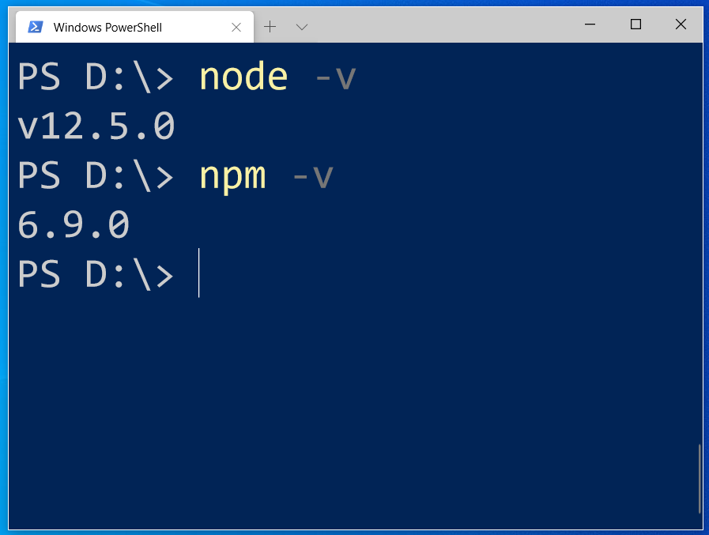
After install NodeJS from nodejs.org
node -v
npm -v

Slide 21
2. From command terminal run:
npm install -g ionic cordova

Slide 22
Now, let’s install the tools

Slide 23
Install VSCode/sublime
NodeJS
Tutorial is here bit.ly/ionickerul
Install Google Chrome Browser
(If you don’t have, you should)

Slide 24
Before we start coding, some basic stuff...

Slide 25
-HTML?
-CSS ?
-TypeScript ?

Slide 26
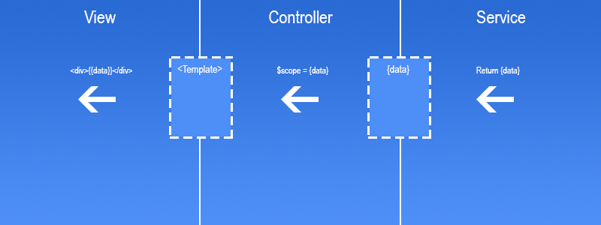
Simple MVC in Ionic
.HTML | .TS | services .TS /Model

Slide 27
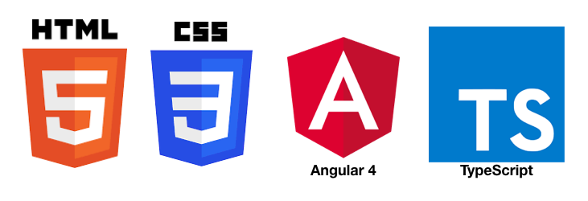
HTML
-Hyper Text Mark Up Language (HTML)
-Used to display the interface
-Write in tags,
-Example- <strong>Hello</strong> → Hello
-Ionic has its own built in tags
<ion-list></ion-list>
<ion-item></ion-item>
<ion-grid></ion-grid>
-HTML in Ionic is “AngularJS Flavoured”
-Have to use Angular Syntax for data and clicks
-Example- (click), *ngFor etc

Slide 28
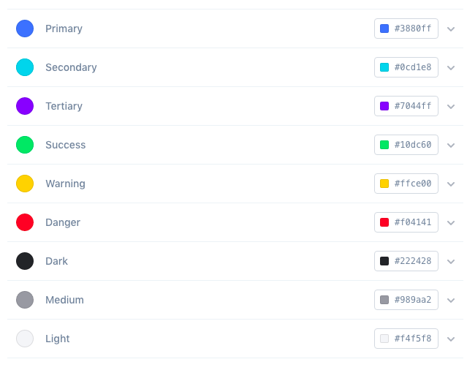
CSS or SCSS
-Cascading Style Sheets (CSS)
-Used for styling, very straightforward
-Each generated Ionic page comes with built in own CSS
-Can assist in ‘theming’ the app
-Ionic has standard built in colours
-Primary, Secondary, Danger, Light & Dark
Built in colours that can be added/edited

Slide 29
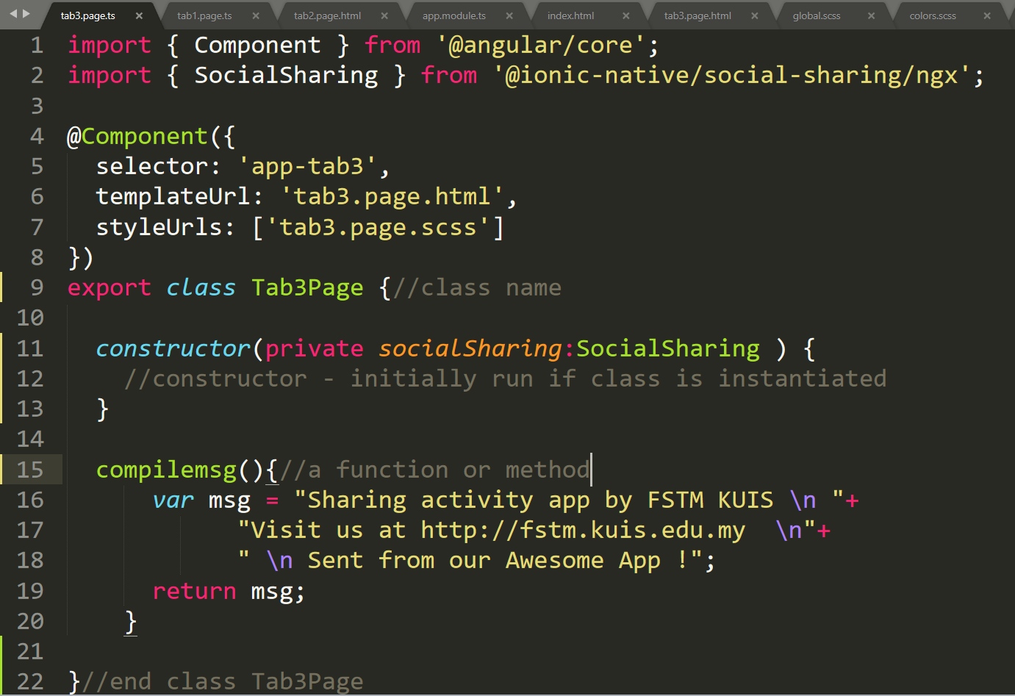
Class Function

Slide 30
Hello World ionic

Slide 31
1. Start a project
ionic start appfstm tabs

Slide 32
2. CD into Directory & Run the project
ionic serve

Slide 33


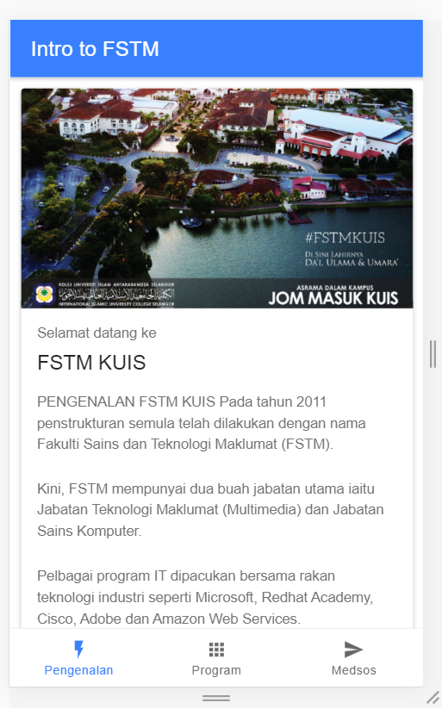
Next tab2 and tab3

Slide 34


bit.ly/ionkerul
T02 HTML interface
(antaramuka)

Slide 35
1. Start a project
ionic start appfstm tabs

Slide 36
2. CD into Directory & Run the project
ionic serve

Slide 37
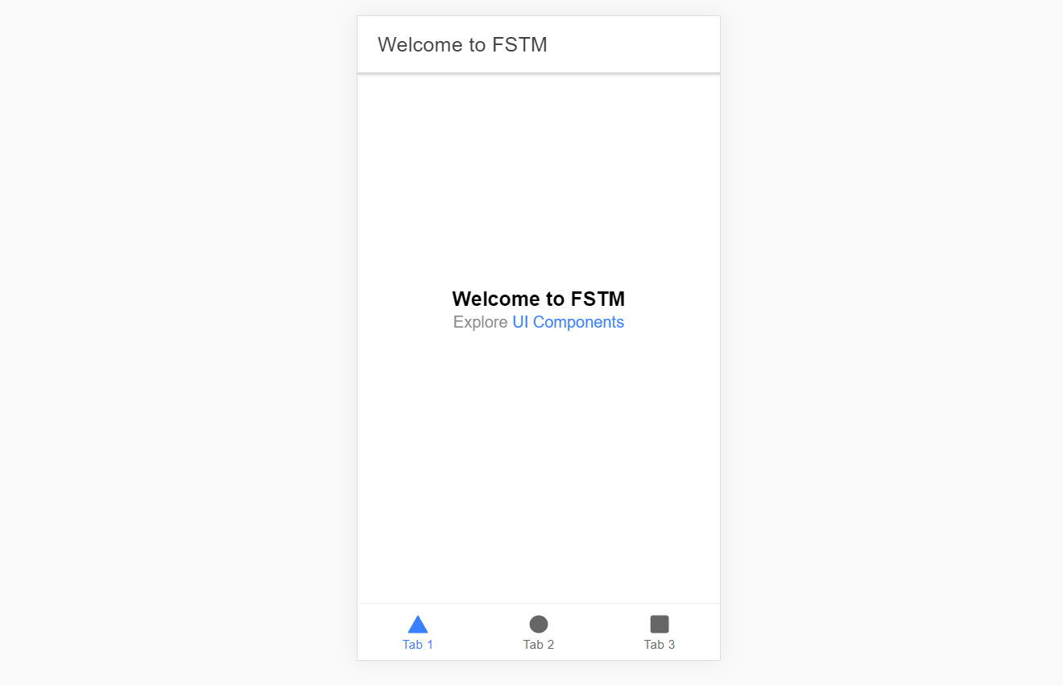
Output : ionic serve

Slide 38
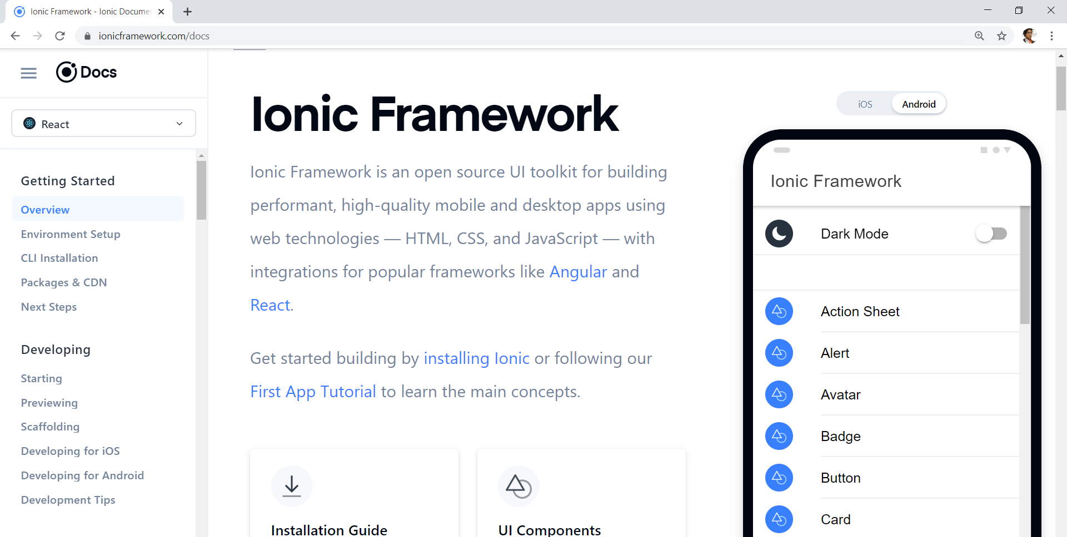
Always refer to documentations: https://ionicframework.com/docs

Slide 39
HTML
-Hyper Text Mark Up Language (HTML)
-Used to display the interface
-Write in tags,
-Example- <strong>Hello</strong> → Hello
-Ionic has its own built in tags
<ion-list></ion-list>
<ion-item></ion-item>
<ion-grid></ion-grid>
-HTML in Ionic is “AngularJS Flavoured”
-Have to use Angular Syntax for data and clicks
-Example- (click), *ngFor etc

Slide 40
CSS or SCSS
-Cascading Style Sheets (CSS)
-Used for styling, very straightforward
-Each generated Ionic page comes with built in own CSS
-Can assist in ‘theming’ the app
-Ionic has standard built in colours
-Primary, Secondary, Danger, Light & Dark
Built in colours that can be added/edited

Slide 41
Next tab2 and tab3

Slide 42
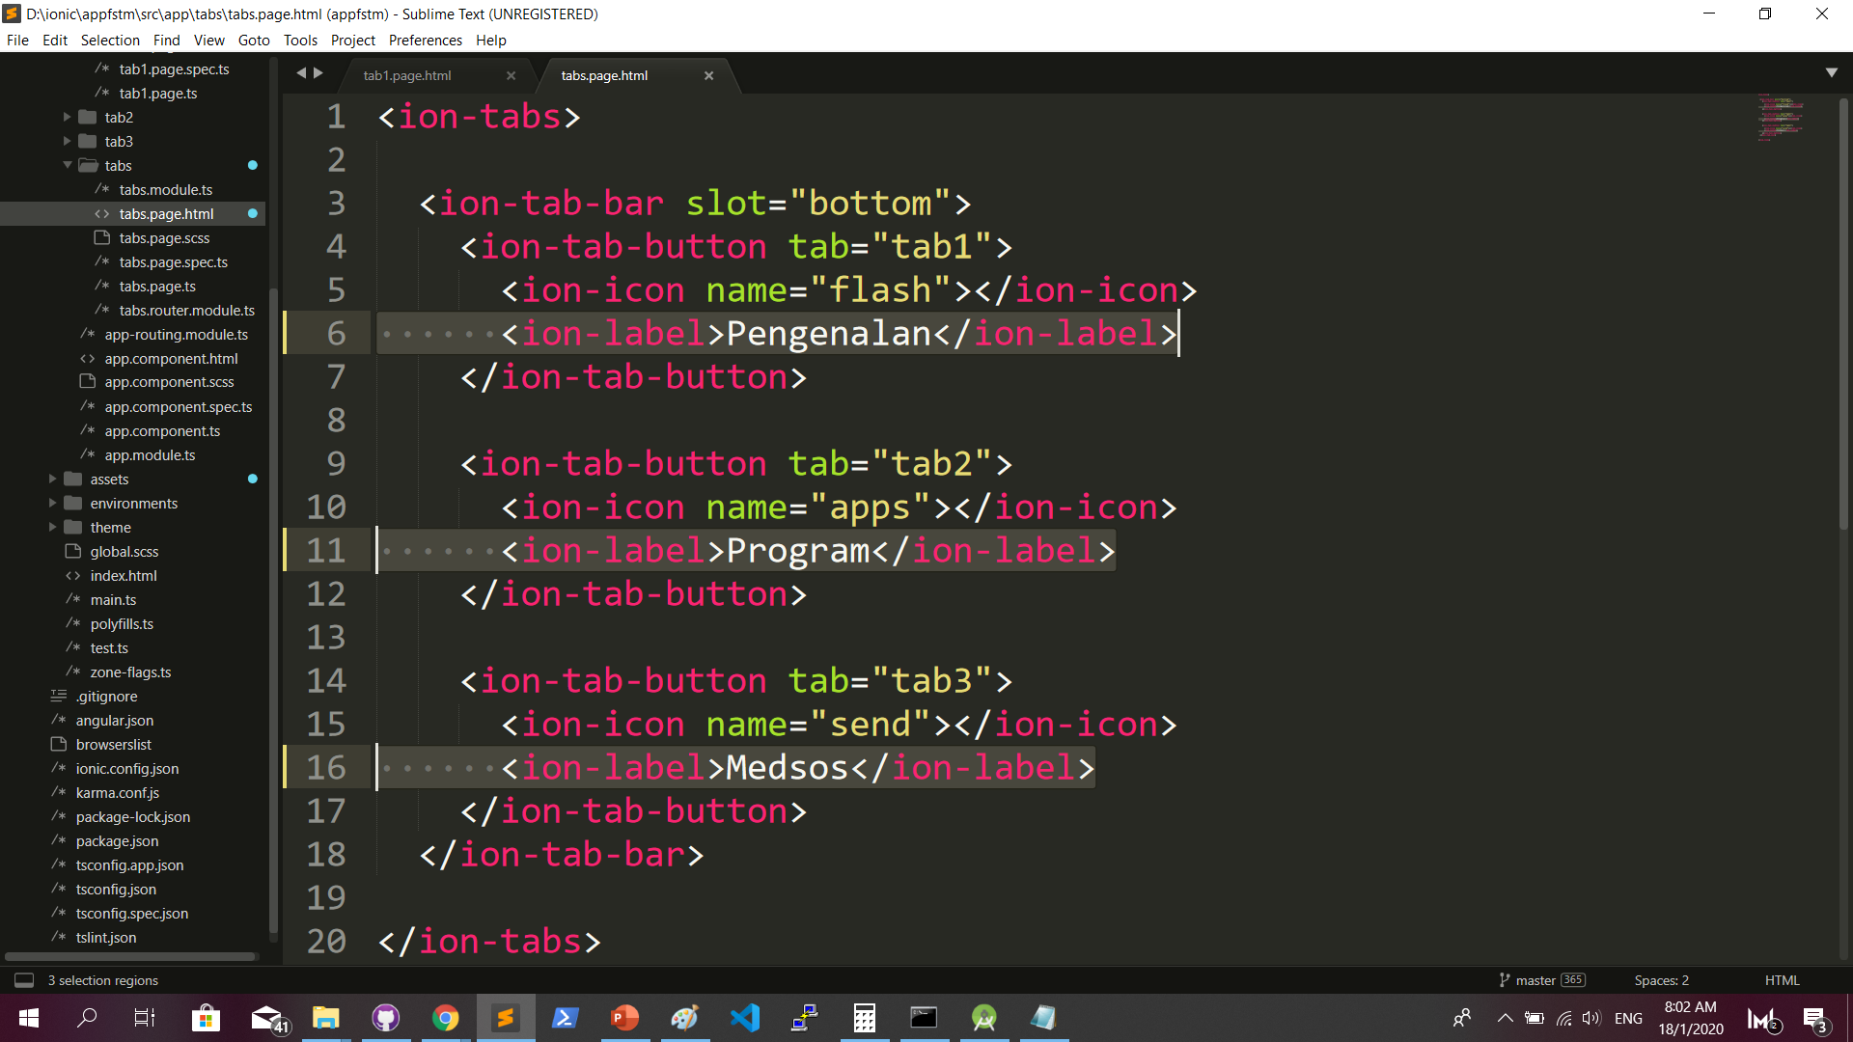
Some interface cosmetics: src/app/tabs/tabs.page.html

Slide 43
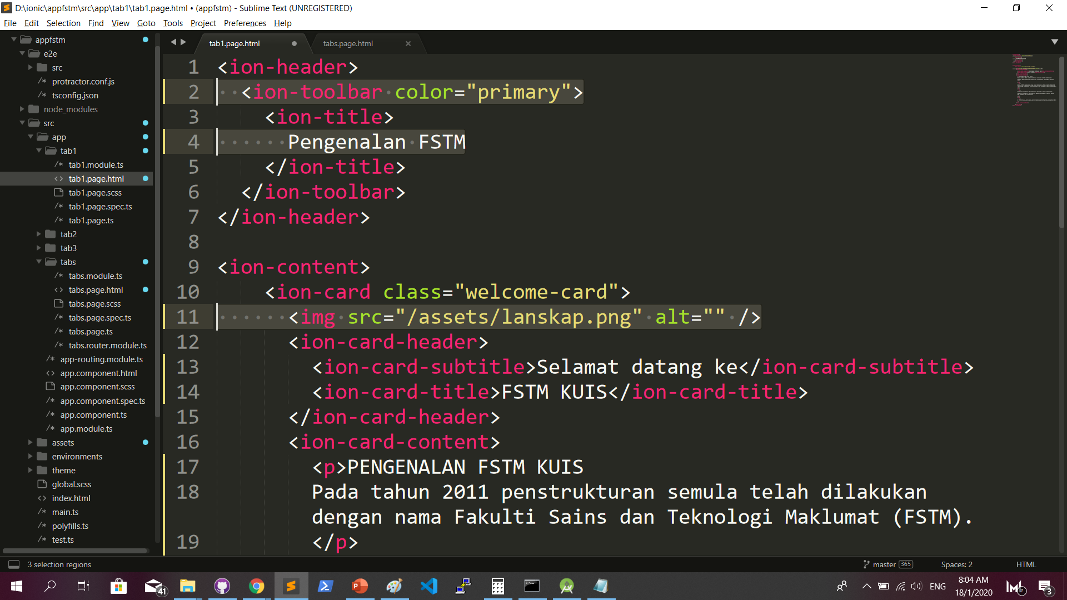
More interface cosmetics: src/app/tab1/tab1.page.html

Slide 44
Run ionic serve

Slide 45
Next tab2 and tab3

Slide 46
Codes & slides github.com/khirulnizam/ionic5

Slide 47
bit.ly/ionkerul
T03 Navigasi
(page navigation)

Slide 48
Page Navigation
+ routerLink (in .html) + NavController (in .ts)

Slide 49
routerLink in HTML
PAGE 1
PAGE 2
See app-routing.module.ts for page name

Slide 50
Exercise : Link to new page
Generate new pages
ionic g page info
ionic g page form

Slide 51
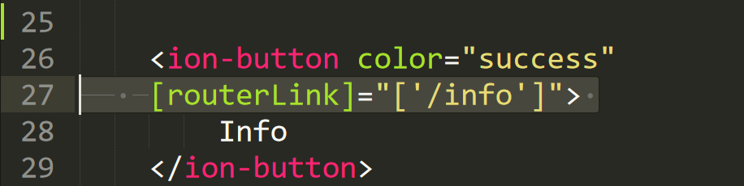
Exercise : Link to new page

Slide 52
NavController in TS
PAGE 1
PAGE 2
See app-routing.module.ts for page name

Slide 53
Add simple form interaction
+ Form Button + Alert function

Slide 54
Try building a button and make an alert
helloWorld(){
alert(“Hello Ionic!”)
}
<ion-button (click)=”helloWorld()”> ALERT </ion-button>
info.page.ts
info.page.html

Slide 55
Codes & slides github.com/khirulnizam/ionic5

Slide 56


T04 TypeScript

Slide 57
TypeScript
-A subset of Javascript
-Part of ECMA6 standard
-The ‘brains’ behind your app
-Used for processing & handling data
Example- calculation, accessing DB etc
-Ionic has standard built in to its TS:
NavController, ModalController etc

Slide 58
Typescript Syntax : Function
let n1:number;
let n2:number;
output:number;
addnumbers(){
output=n1+n2;
displayresult( );
}
displayresult( ){
alert(“Output: ”+output);
}

Slide 59
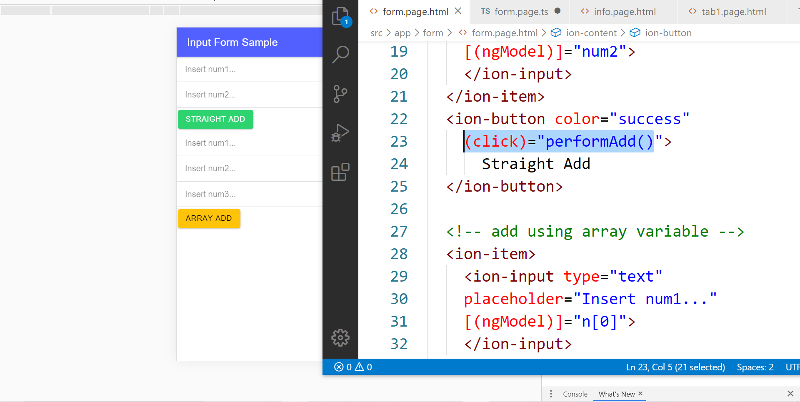
In file .HTML

Slide 60
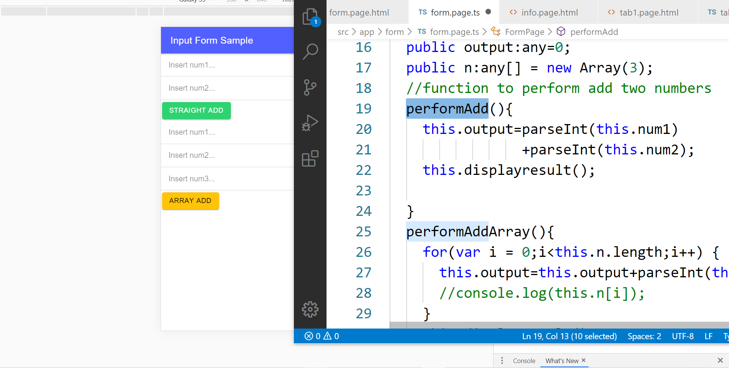
In file .TS

Slide 61
TypeScript Syntax : EX1 variable
What is a variable?
A variable acts as a container for values in a programming code.
var pi:number = 3.14;
Var num1:number=5;
var name:string =“enKerul”;
Use any to loosely-type the variable data type.
Data types:
any
can be numbers or strings
string
“this is string ” + “ concat ”
number
Double 3.14, or integer 5
array
can be a collection of Var, Strings or Objects

Slide 62
Typescript Syntax : EX2 String manipulation & Casting
//to convert String to number
var str = "54";
//easy way by using + operator
var num = +str; var num = parseInt(str);
String manipulation?
var str:string = "3.14";
var pi:number = 3.14;
console.log("pi is "+pi);
console.log("tau is "+(2 * pi));

Slide 63
Typescript Syntax : EX3 Array
Array? Array
can be a collection of Var, Strings or Objects
// A list literal.
var numbers = [4, 1, 5, 6, 3, 2];
for(var i=0;i<numbers.length; i++)
{
sum=sum+numbers[i]);
console.log(“Sum: ”+sum);
}
-----
Output
Sum: 21

Slide 64
Typescript Syntax : EX4 Associative array
Associative Array?
Array with key and value pairs (not index number).
// A map literal.
// Asociative array
var gases = [
'He': 'Helium',
'Ne': 'Neon',
'Ar': 'Argon’,
];
console.log(gases['Ne’]);
-------------------------
Output: Neon

Slide 65
T05 Navigasi (navigation with parameters)

Slide 66
Parameters
2 methods

Slide 67
Using Services,
SEE DAY 2 LESSON
2. Using ActivatedRoute
*CAN SEND OBJECTS
*CANNOT SEND OBJECTS

Slide 68
PARAMETERS
PAGE 1
PAGE 2
Name: Kerul
Name: Kerul
Name: Kerul

Slide 69
Using ActivatedRoute
On app-routing.module.ts add param name, example /:id
Add /id when navigating
To get param
import {ActivatedRoute} from ‘@angular/router’
public route:ActivatedRoute
let the_id=this.route.snapshot.params.id

Slide 70
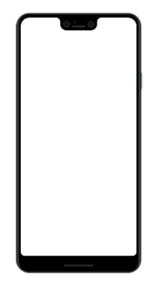

Ionic vs Flutter
bit.ly/ionkerul

Slide 72
T06 Pilihan Selection : if…else, ngIF

Slide 73
T07 Ulangan Repetition : for, foreach, ngFOR

